Slide 1
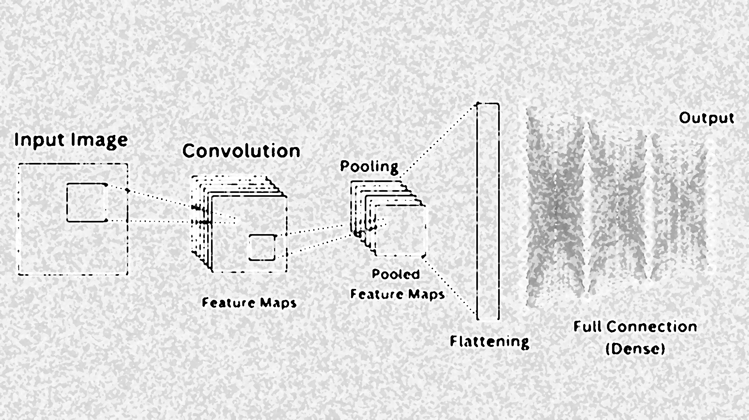

Lecture 13: Convolutional Neural Network
CSE445 Machine Learning
Dr. Jilan Samiuddin (JSA)
Assistant Professor
North South University

Slide 2
Introduction
CNN is a neural network specialized for grid-like data, especially images (pixels on a 2D grid)
Learns to automatically extract features (edges, textures, shapes, objects) directly from raw pixels
Local connectivity: each neuron “looks” at a small region (receptive field) instead of the whole image at once
Weight sharing: the same filter is used across the entire image → fewer parameters, more efficient
Hierarchical features: early layers learn simple patterns (edges), deeper layers learn complex concepts (objects)
Typical applications:
Image classification (cat vs. dog)
Object detection and segmentation (self-driving cars, medical imaging)
Face recognition, Optical Character Recognition, and many more vision tasks

Slide 3
Image Types
RGB image
Has 3 channels: Red, Green, Blue
Each pixel is stored as a triplet: (𝑅,𝐺,𝐵)
Typical shape: H × W × 3
B&W (Grayscale) image
Has 1 channel: intensity (brightness only)
Each pixel is a single value
Typical shape: H × W (or H × W × 1)

Slide 4
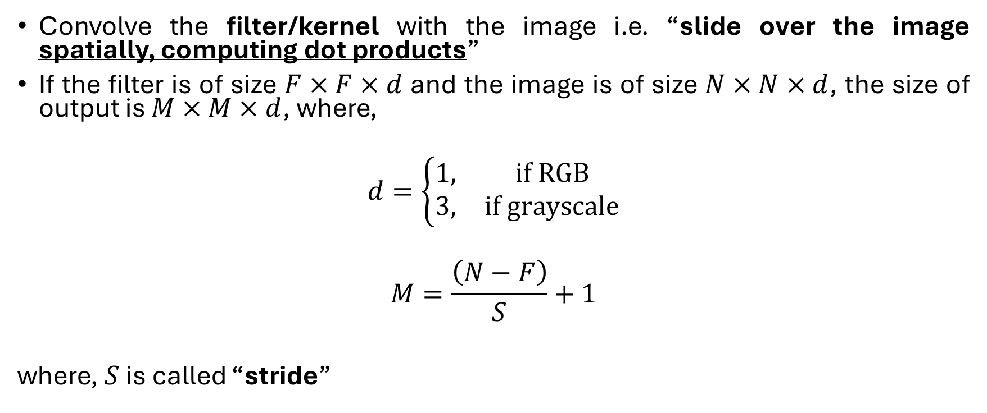
The Idea of a CNN
Convolve the filter/kernel with the image i.e. “slide over the image spatially, computing dot products”
If the filter is of size $F×F×d$ and the image is of size $N×N×d$, the size of output is $M×M×d$, where,
$$d=\left\{\begin{matrix}1, & if RGB \\ 3, & if grayscale\end{matrix}\right.$$
$$M=\frac{\left(N−F\right)}{S}+1$$
where, $S$ is called “stride”

Slide 5
Intuition
Each filter is like a “pattern detector” (e.g., vertical edge, corner, texture)
The activation map shows where in the image that pattern appears and how strongly
Bright/large values in the activation map → “I see my pattern here strongly”
Dark/small values → “My pattern is weak or absent here”

Slide 6
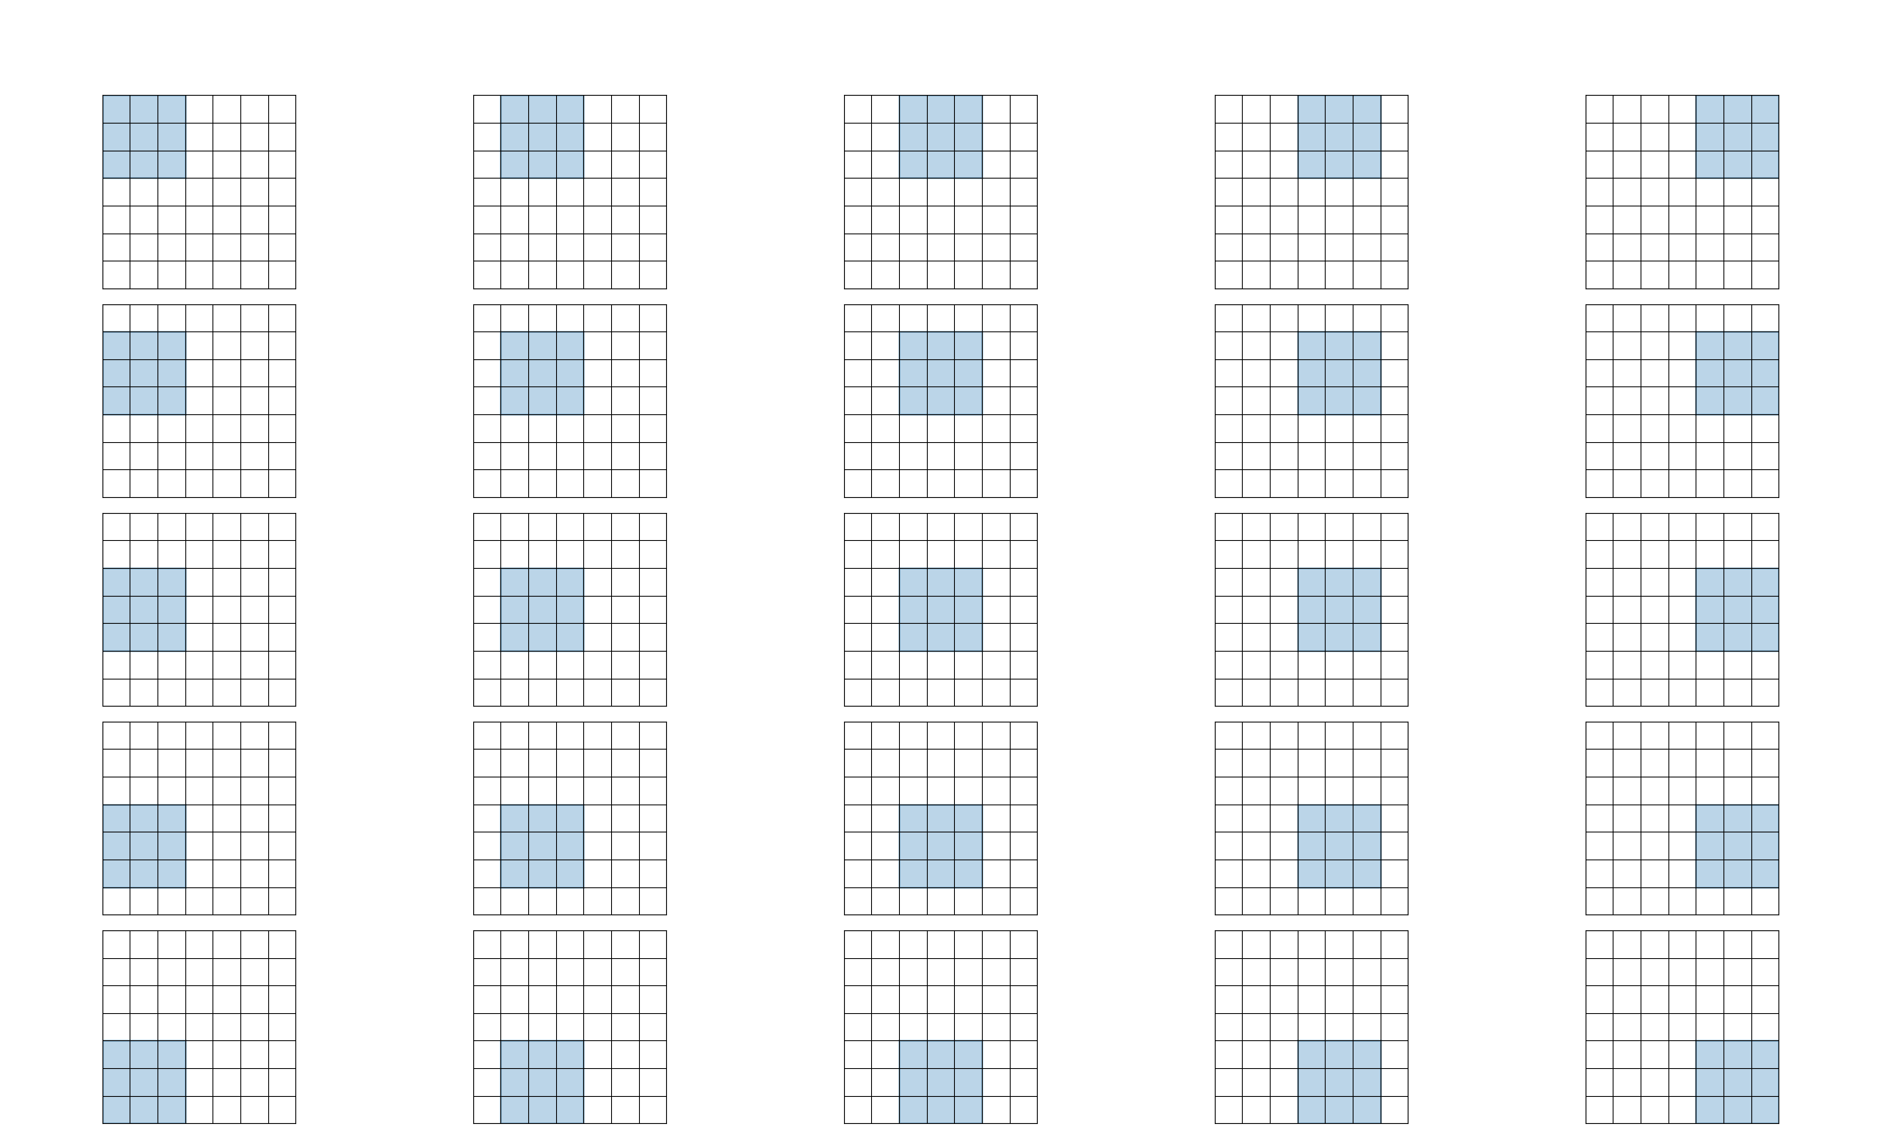
3×3 Filter Sliding on 7×7 Image (Stride=1)

Slide 7
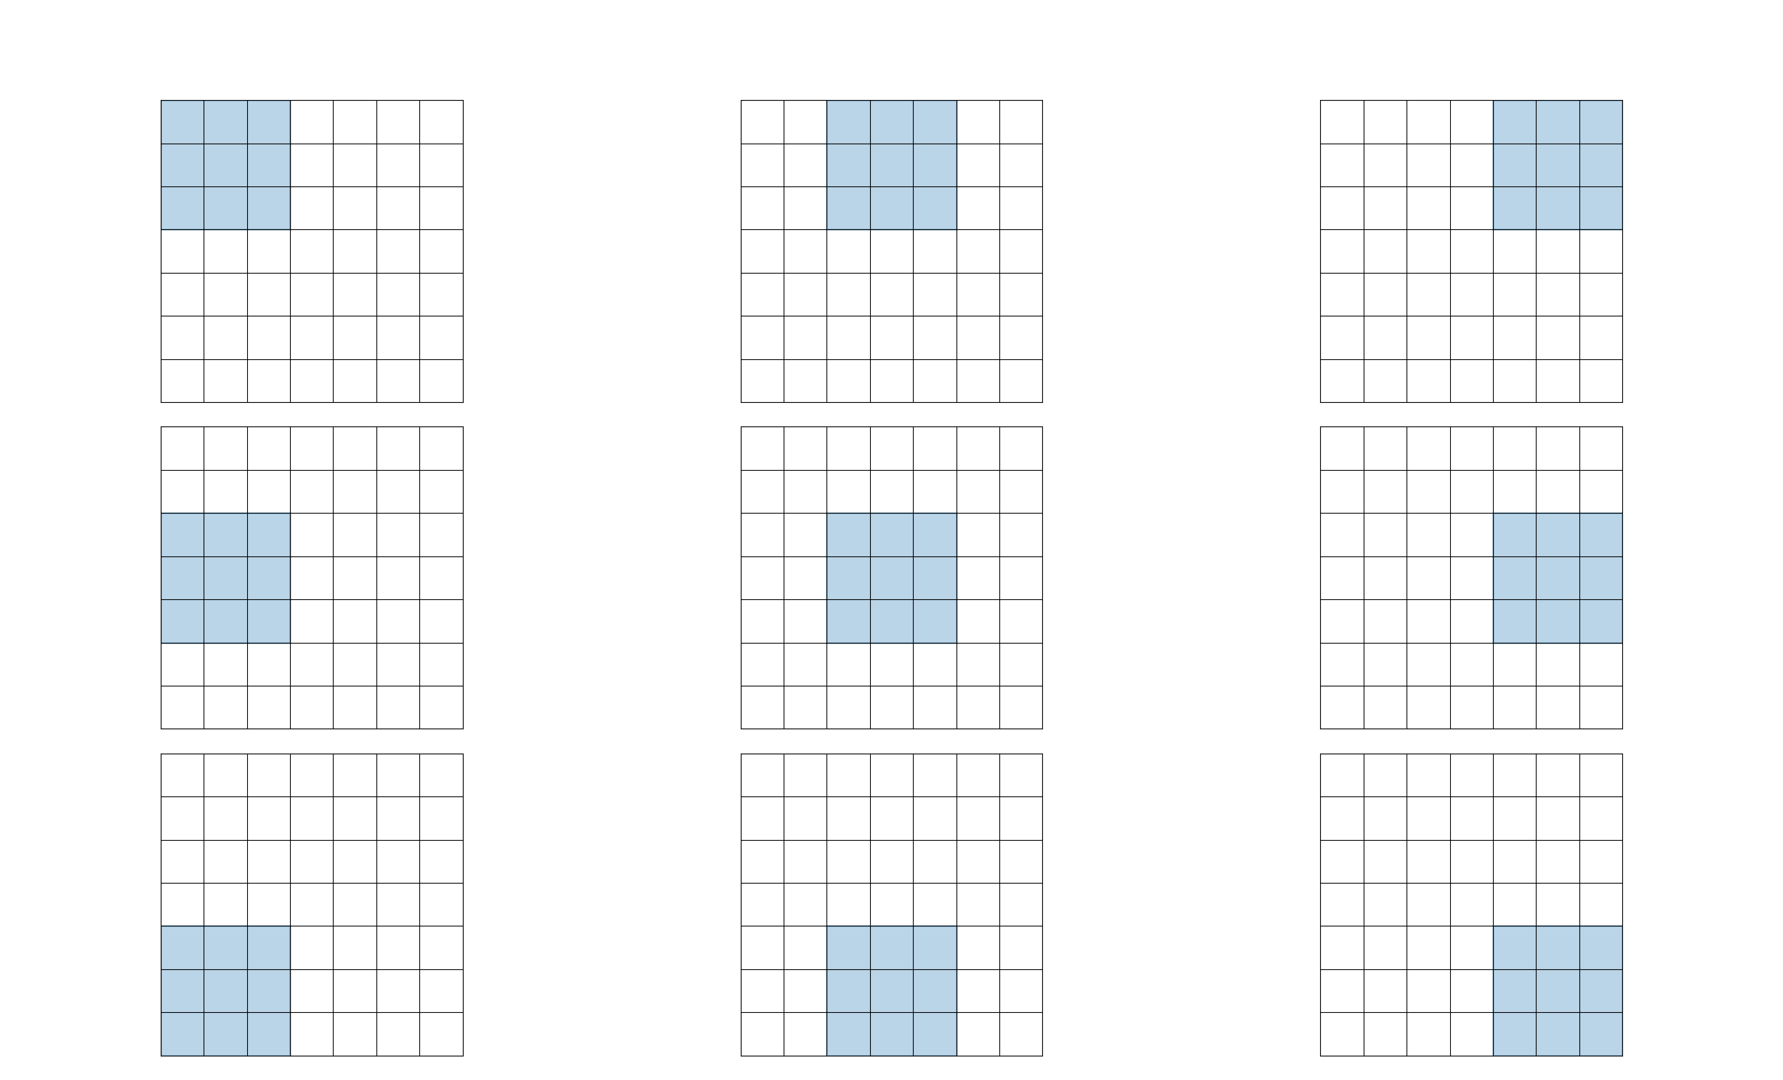
3×3 Filter Sliding on 7×7 Image (Stride=2)

Slide 8
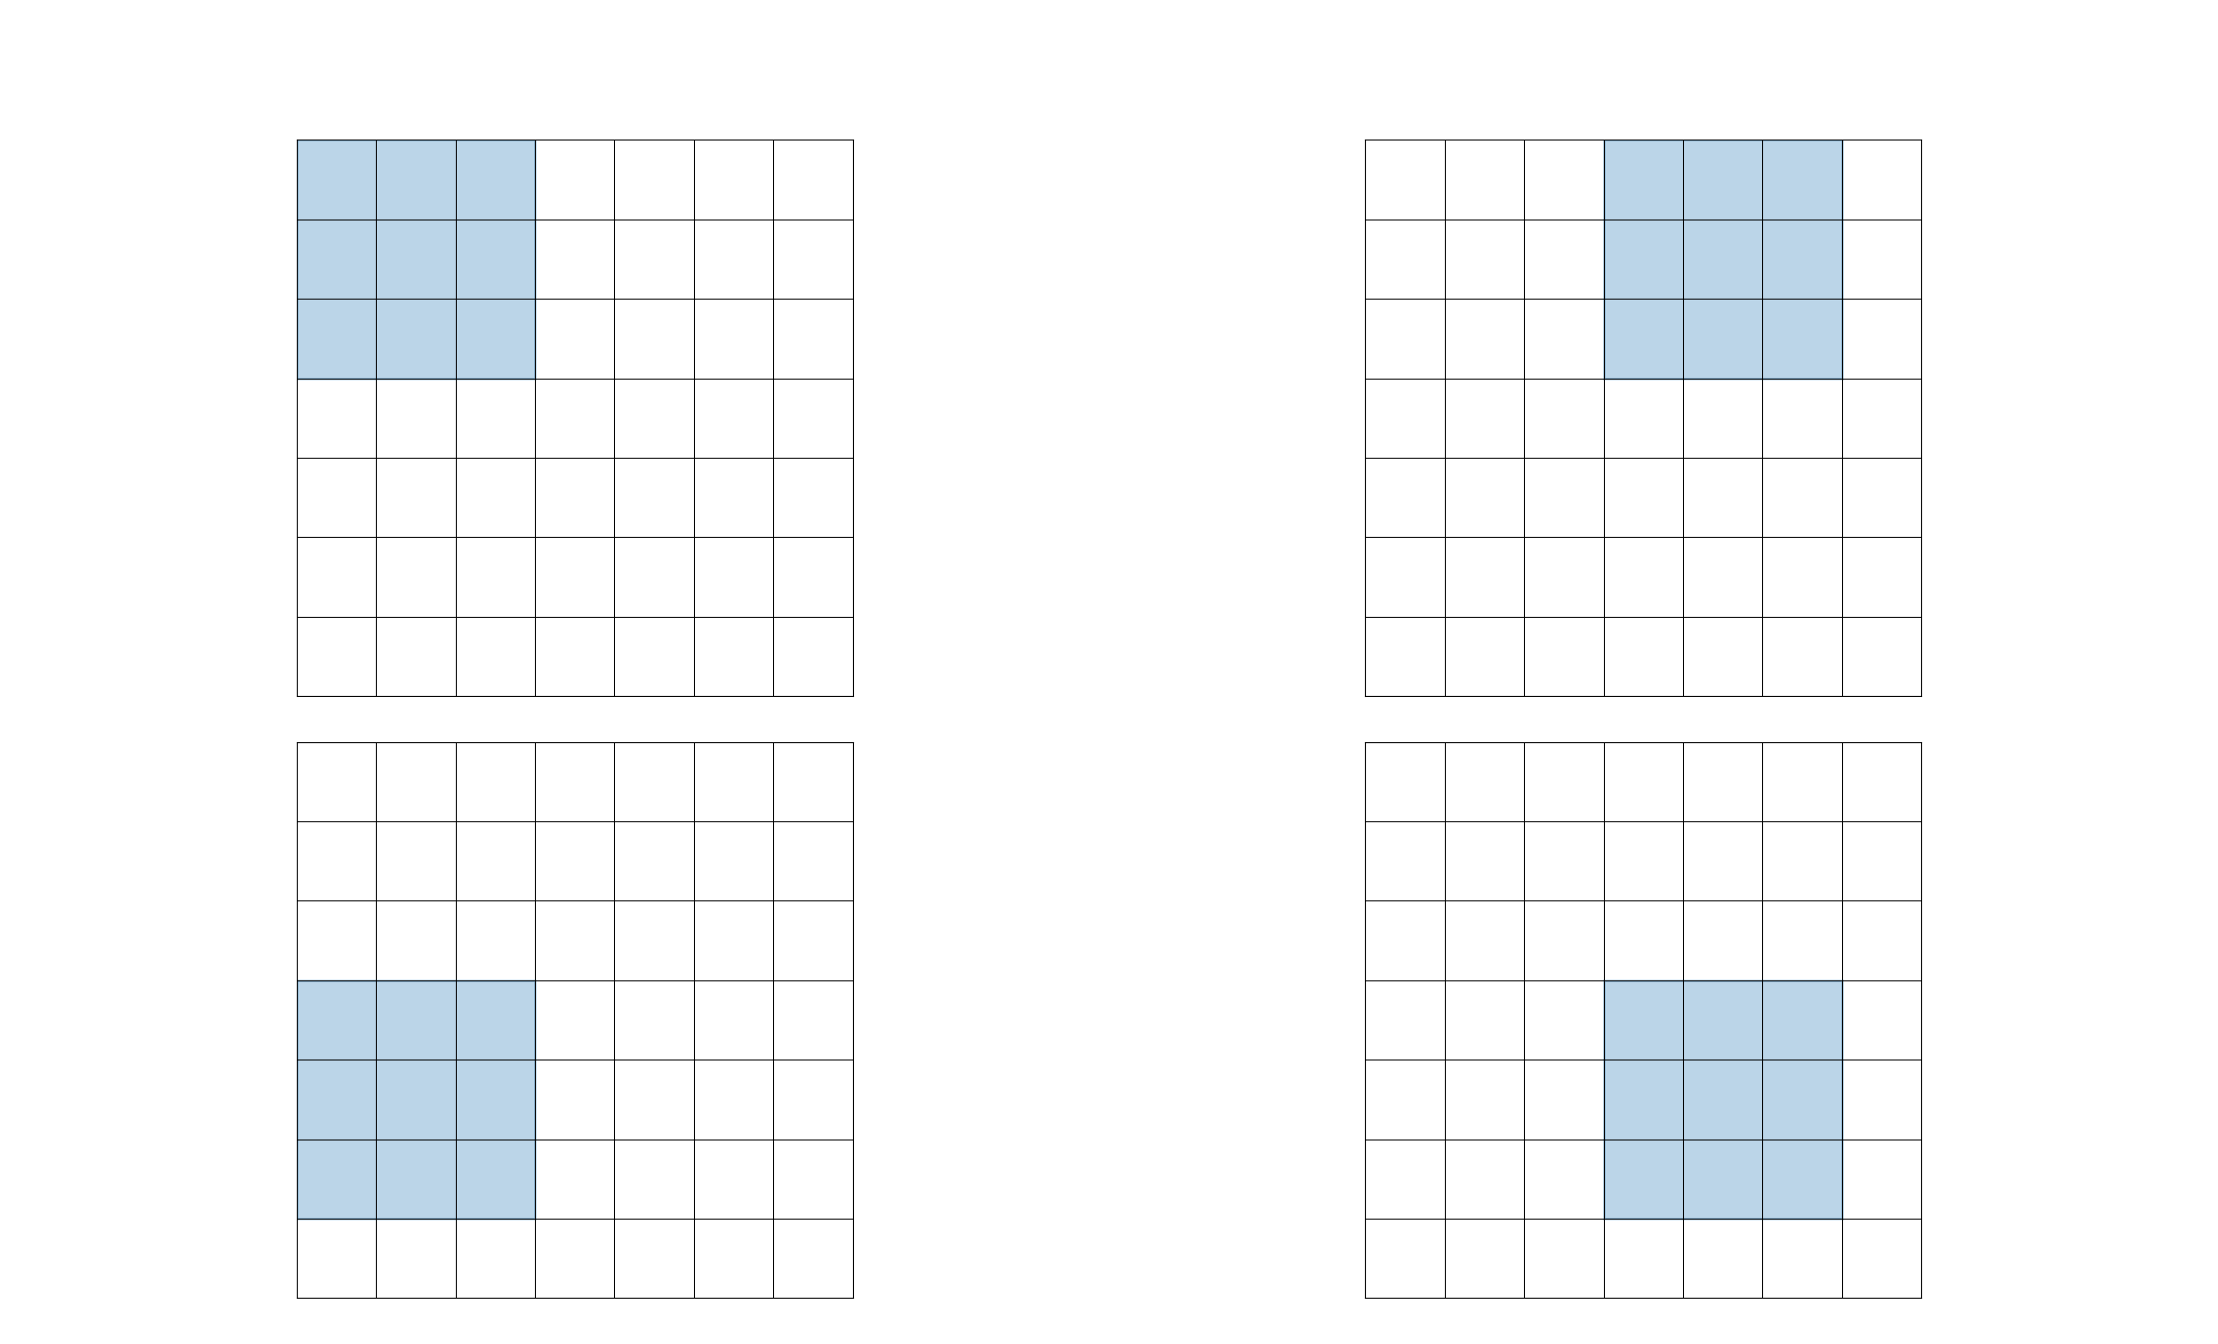
3×3 Filter Sliding on 7×7 Image (Stride=3)
What is the issue in this?
It does not fit! cannot apply 3x3 filter on 7x7 input with stride 3

Slide 9
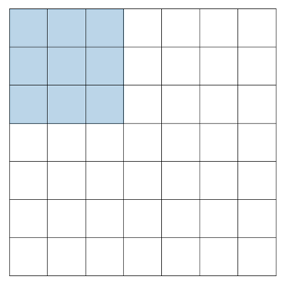
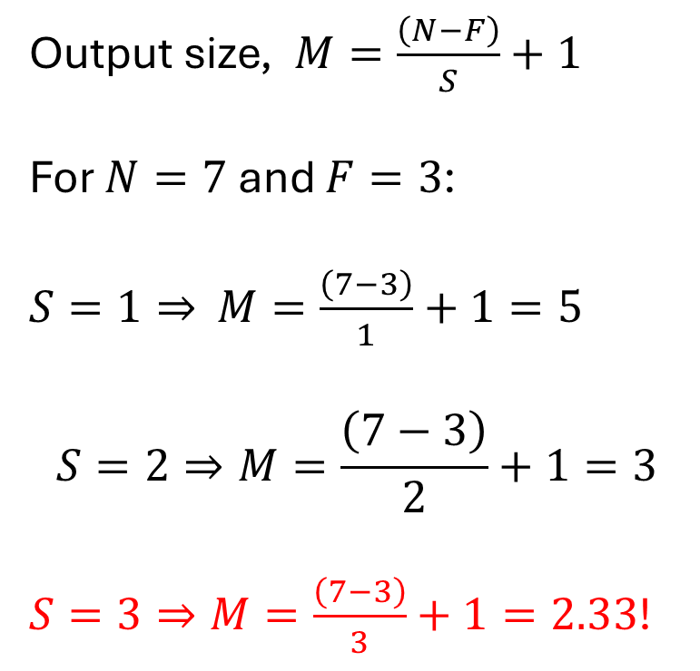
Output Size
Output size, $M=\frac{\left(N−F\right)}{S}+1$
For $N=7$ and $F=3$:
$S=1⇒$ $M=\frac{\left(7−3\right)}{1}+1=5$
$$S=2⇒M=\frac{\left(7−3\right)}{2}+1=3$$
$S=3⇒M=\frac{\left(7−3\right)}{3}+1=2.33$!
F
F
N
N

Slide 10
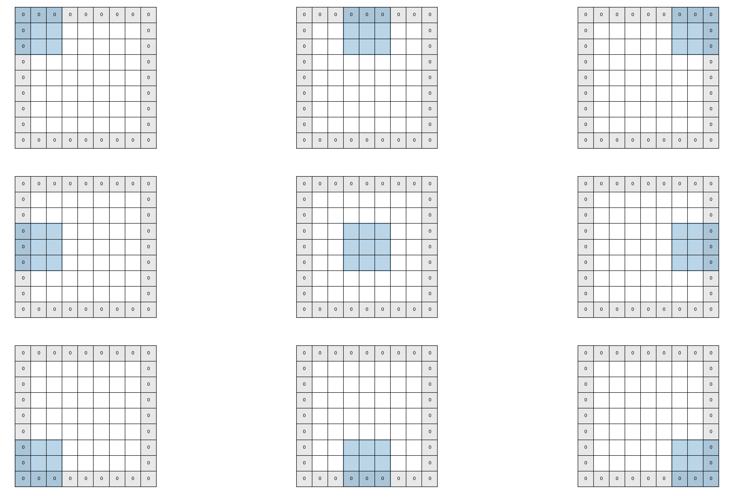
Common Solution: Zero padding the border

Slide 11
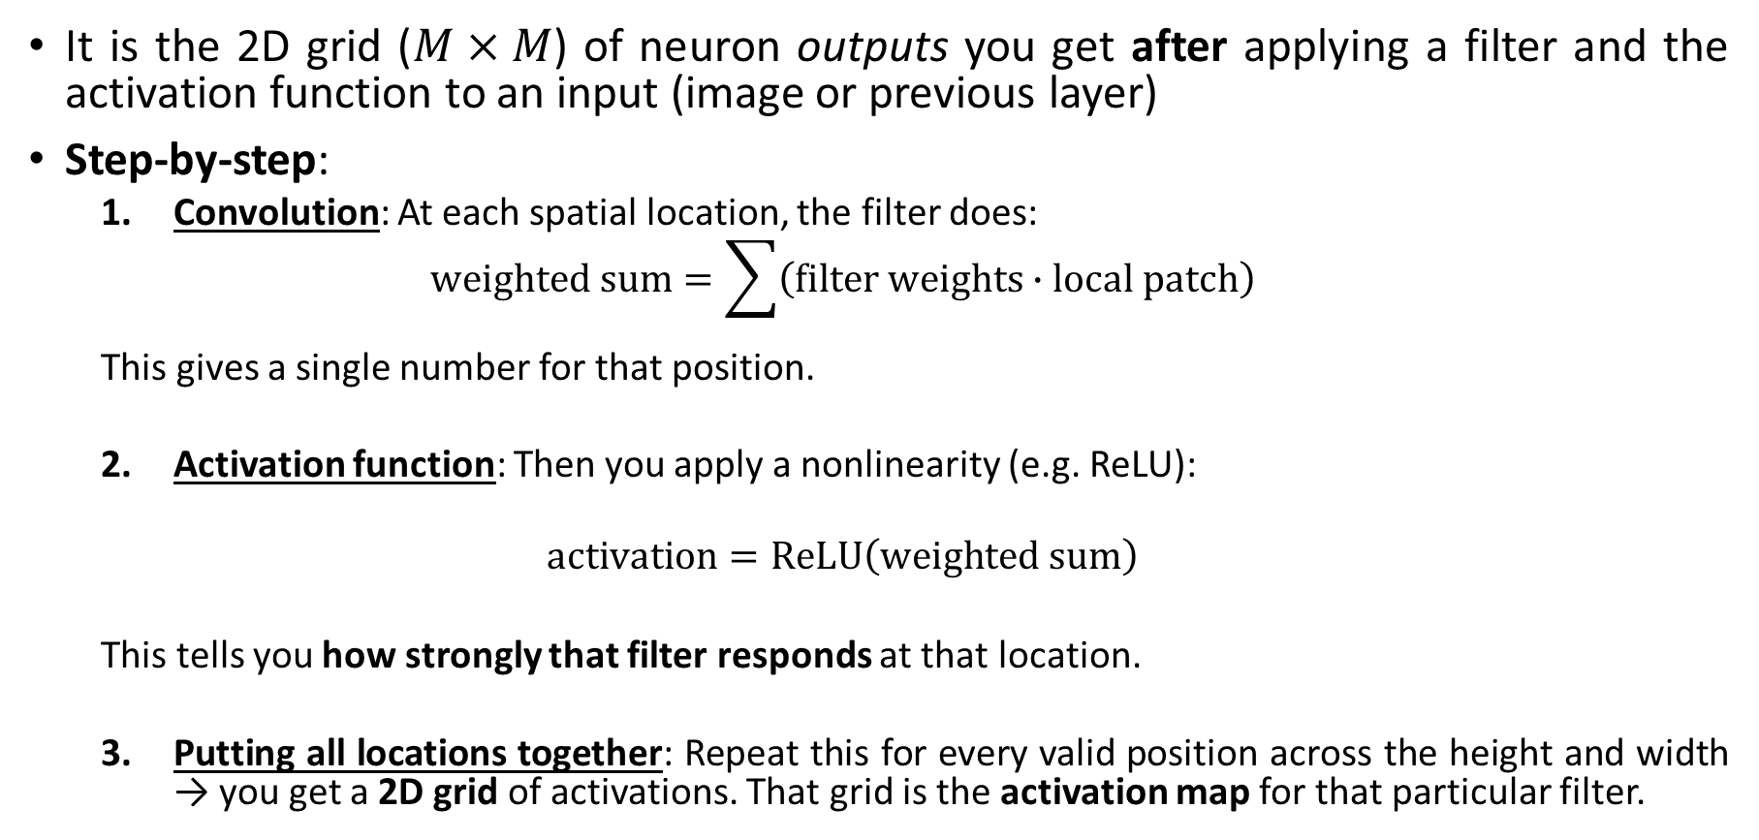
Activation Map
It is the 2D grid ($M×M$) of neuron outputs you get after applying a filter and the activation function to an input (image or previous layer)
Step-by-step:
Convolution: At each spatial location, the filter does:
$$weighted sum=\sum{\left(filter weights∙local patch\right)}$$
This gives a single number for that position.
Activation function: Then you apply a nonlinearity (e.g. ReLU):
$$activation=ReLU\left(weighted sum\right)$$
This tells you how strongly that filter responds at that location.
Putting all locations together: Repeat this for every valid position across the height and width → you get a 2D grid of activations. That grid is the activation map for that particular filter.

Slide 12
Activation Map: Example

Slide 13
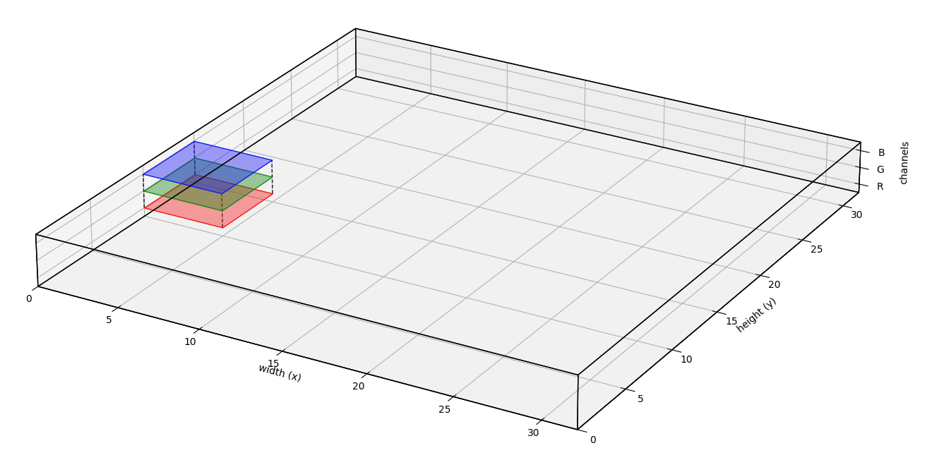
Convolution on RGB Image

Slide 14
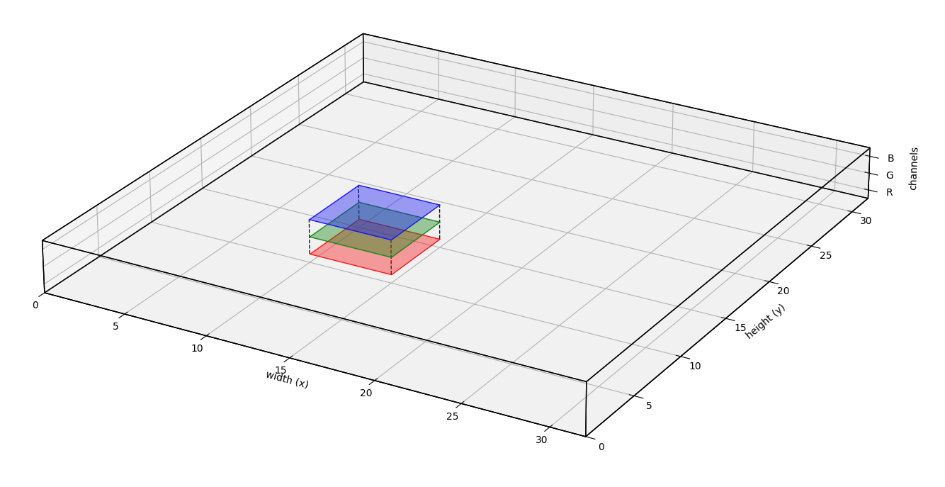
Convolution on RGB Image

Slide 15
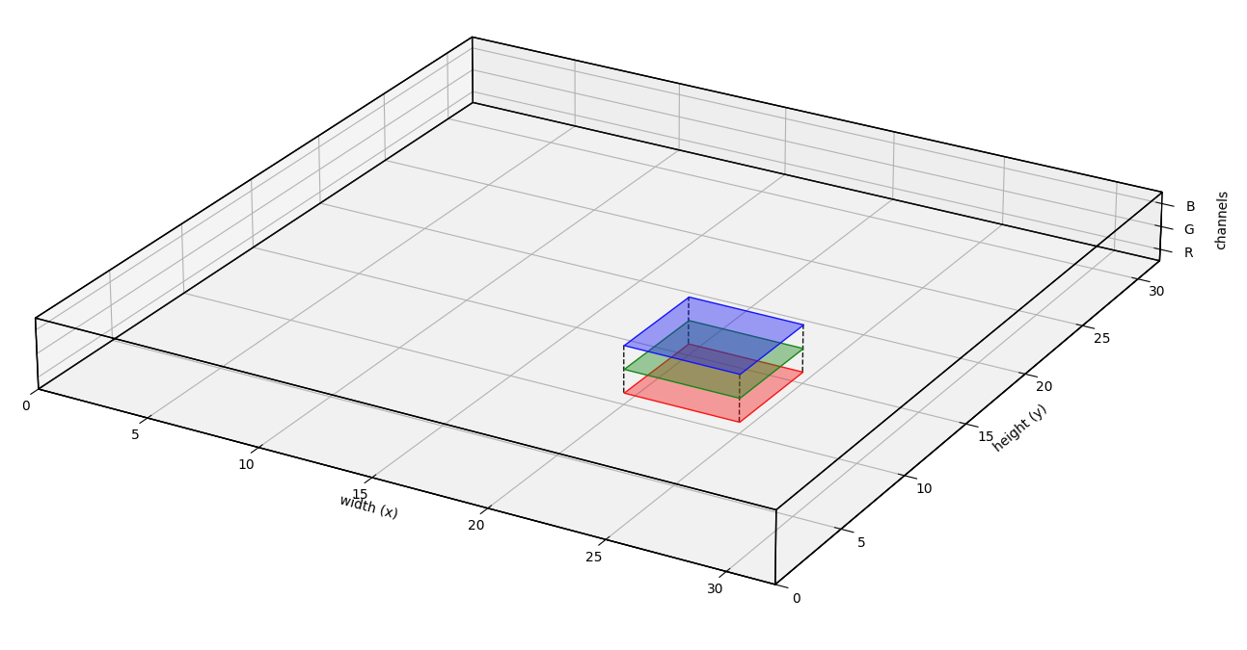
Convolution on RGB Image

Slide 16
Mathematical Formulation of CNN

Slide 17
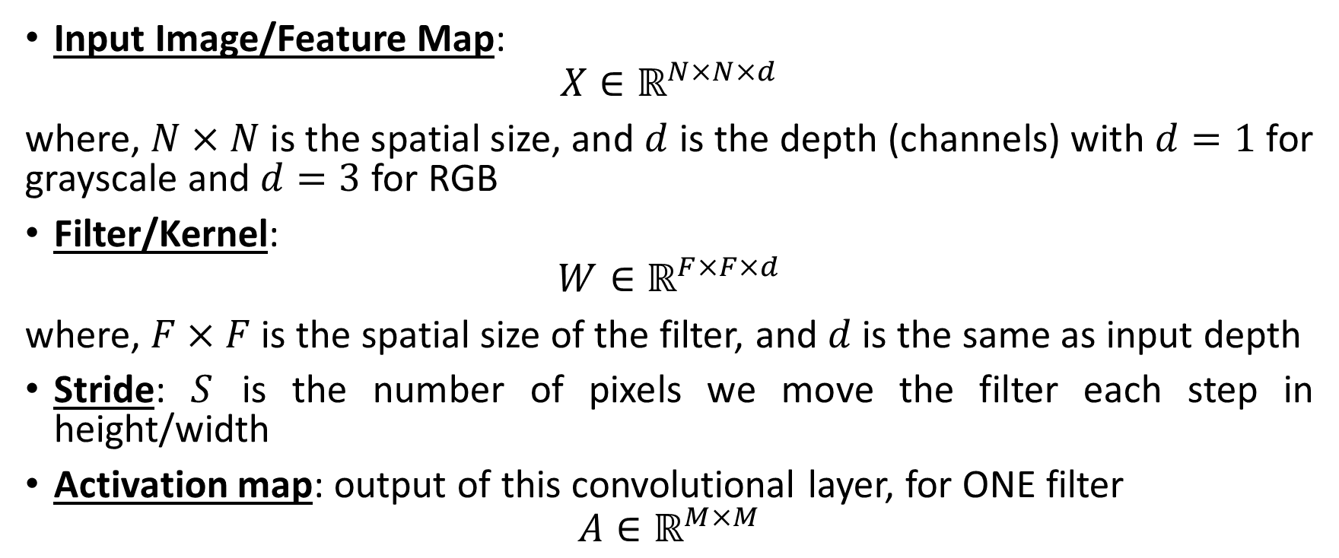
Shapes and notations
Input Image/Feature Map:
$$X∈ℝ^{N×N×d}$$
where, $N×N$ is the spatial size, and $d$ is the depth (channels) with $d=1$ for grayscale and $d=3$ for RGB
Filter/Kernel:
$$W∈ℝ^{F×F×d}$$
where, $F×F$ is the spatial size of the filter, and $d$ is the same as input depth
Stride: $S$ is the number of pixels we move the filter each step in height/width
Activation map: output of this convolutional layer, for ONE filter
$$A∈ℝ^{M×M}$$

Slide 18
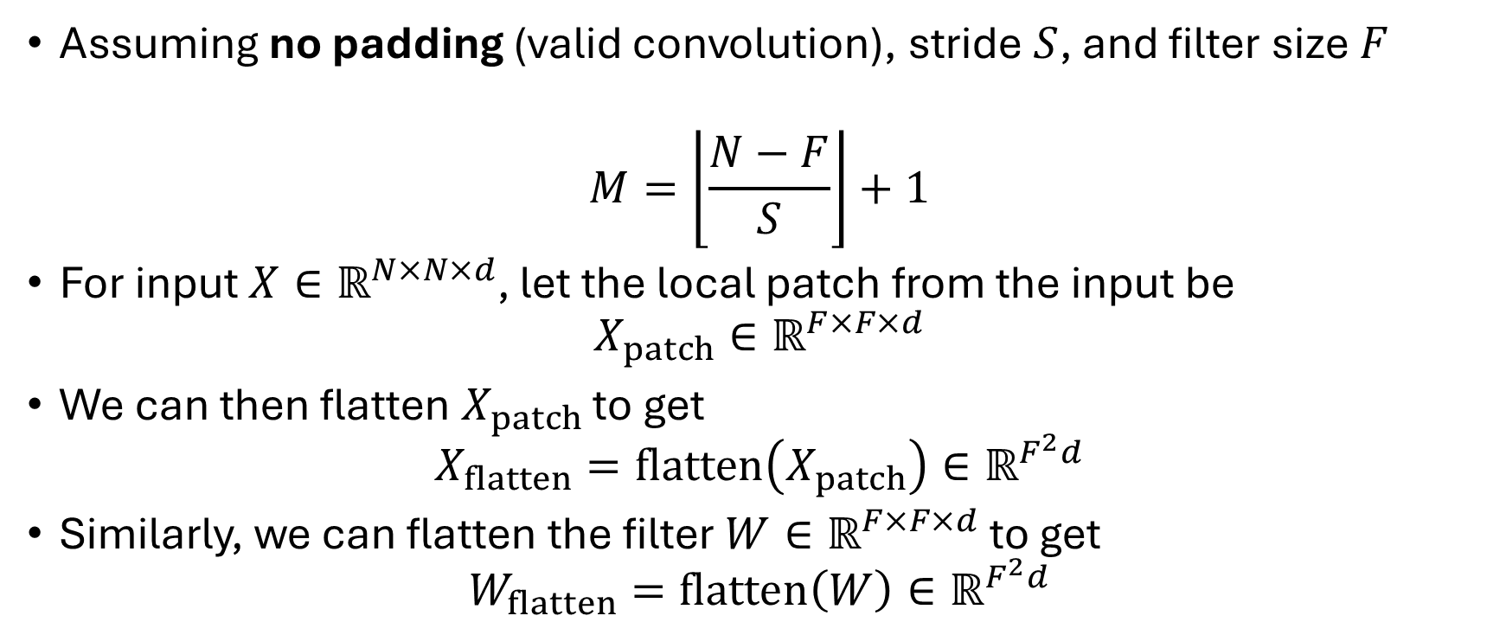
Activation Map (no padding)
Assuming no padding (valid convolution), stride $S$, and filter size $F$
$$M=\left\lfloor \frac{N−F}{S}\right\rfloor +1$$
For input $X∈ℝ^{N×N×d}$, let the local patch from the input be
$$X_{patch}∈ℝ^{F×F×d}$$
We can then flatten $X_{patch}$ to get
$$X_{flatten}=flatten\left(X_{patch}\right)∈ℝ^{F^{2}d}$$
Similarly, we can flatten the filter $W∈ℝ^{F×F×d}$ to get
$$W_{flatten}=flatten\left(W\right)∈ℝ^{F^{2}d}$$

Slide 19
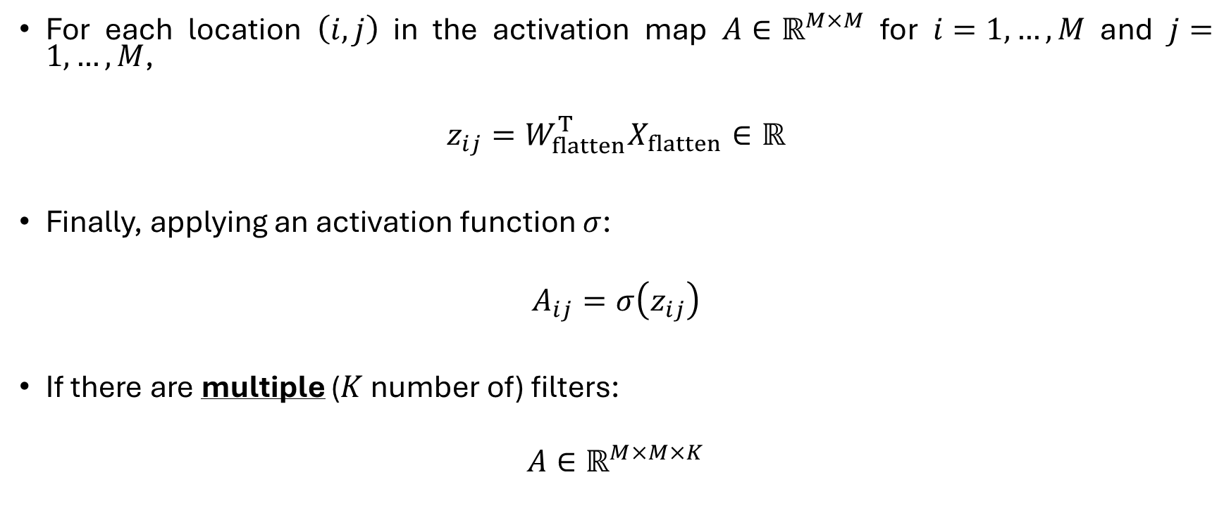
Activation Map (contd.)
For each location $\left(i,j\right)$ in the activation map $A∈ℝ^{M×M}$ for $i=1,…,M$ and $j=1,…,M$,
$$z_{ij}=W_{flatten}^{T}X_{flatten}∈ℝ$$
Finally, applying an activation function $σ$:
$$A_{ij}=σ\left(z_{ij}\right)$$
If there are multiple ($K$ number of) filters:
$$A∈ℝ^{M×M×K}$$

Slide 20
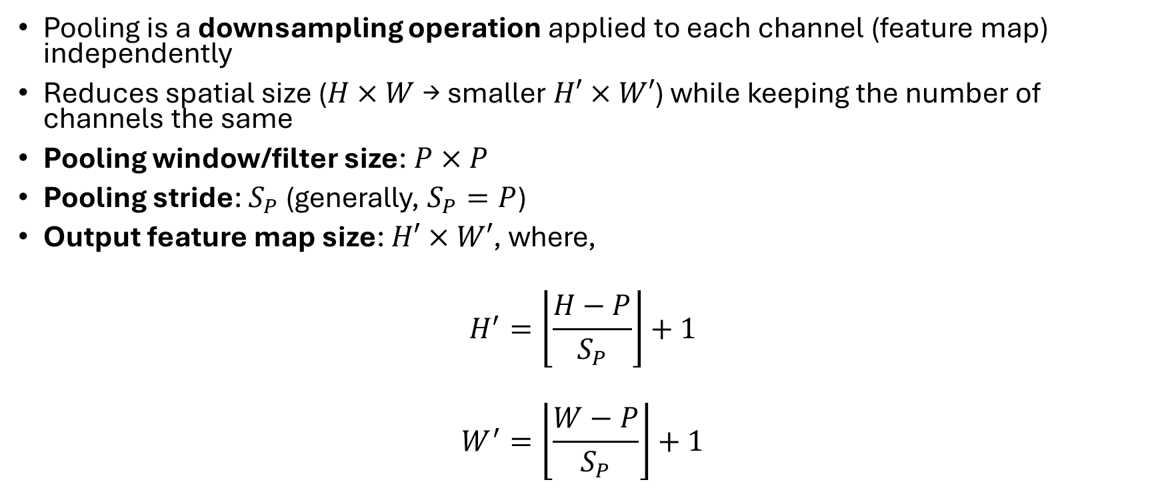
Pooling Layers (Downsampling Feature Maps)
Pooling is a downsampling operation applied to each channel (feature map) independently
Reduces spatial size ($H×W$ → smaller $H′×W′$) while keeping the number of channels the same
Pooling window/filter size: $P×P$
Pooling stride: $S_{P}$ (generally, $S_{P}=P$)
Output feature map size: $H′×W′$, where,
$$H^{′}=\left\lfloor \frac{H−P}{S_{P}}\right\rfloor +1$$
$$W^{′}=\left\lfloor \frac{W−P}{S_{P}}\right\rfloor +1$$
Pooling intuitive video example:
Click here

Slide 21
Types of Pooling
Max pooling
For each P×P window:
output=max⁡ of all values in the window
Keeps the strongest activation (strongest evidence of a feature)
More commonly used than other types of pooling
Average pooling
For each P×P window
output=average of all values in the window
Smooths values
Less used in modern CNNs

Slide 22
Why Pooling?
Reduces computation & parameters in later layers (smaller feature maps)
Acts as a form of regularization, helping prevent overfitting

Slide 23
Fully-Connected (FC) Layers
Acts like a standard MLP (feedforward neural network) layer at the end of the CNN
Role in a CNN:
Convolution + pooling: learn spatial features (edges, textures, shapes, objects)
Fully-connected layers: use those features to make global decisions, e.g., “Is this a cat, dog, or car?”

Slide 24
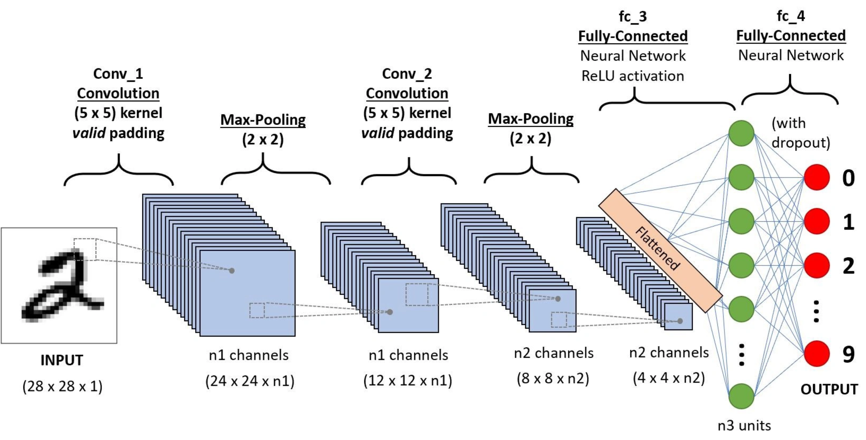
An example architecture of a CNN
Image source: AnalyticsVidhya.com

Slide 25
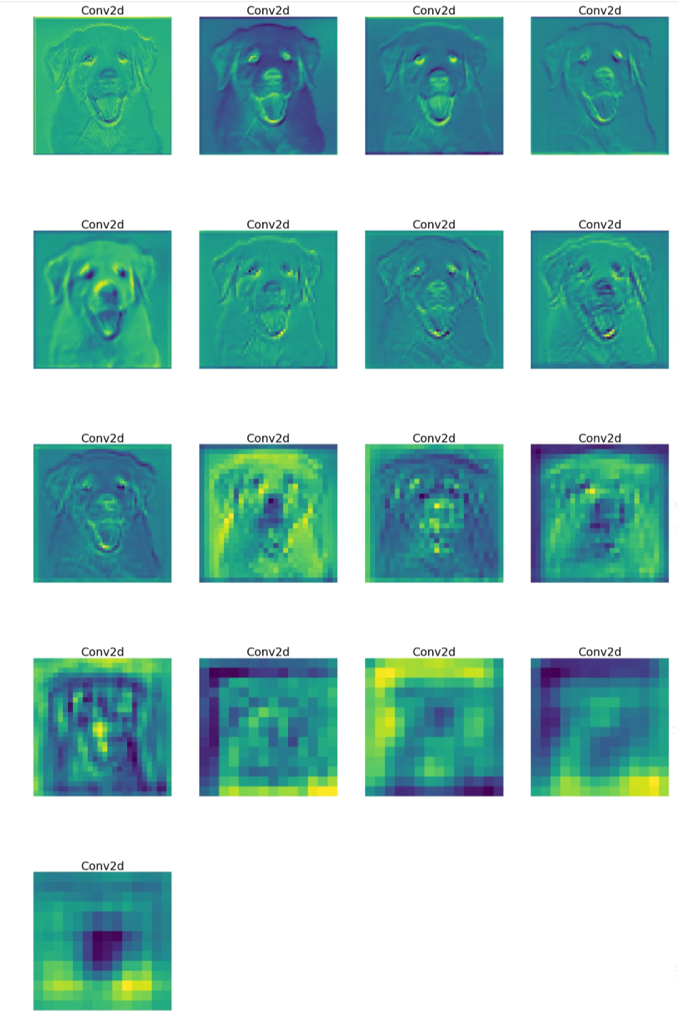
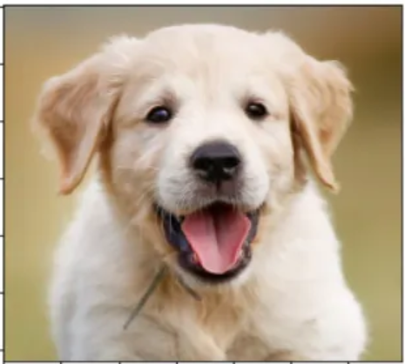
An example of an inference
Early layers are usually more interpretable and preserve most of the low-level information in the input image
As we move deeper into the network
the features become less visually intuitive and more abstract
focuses on class-specific patterns while discarding more general image details
Original Image
Total convolution layers: 17
Image source: Medium.com

Slide 26
CNNs – Backbone of Modern Vision Algorithms
CNNs learn hierarchical visual features (edges → textures → parts → objects) directly from pixels, making them the standard backbone for most computer vision systems
Image classification
Models like ResNet, VGG: “Is this a cat, dog, or car?”
Object detection
Faster R-CNN, YOLO, SSD: draw boxes + labels around objects in an image
Semantic & instance segmentation
U-Net, Mask R-CNN: classify every pixel (e.g., road vs. car vs. pedestrian).

